Slide 1
CURRENT REGULATED POWER SUPPLY MODULE
FOR HEATING THE CATHODE OF ELECTRIC PLASMA THRUSTER
Presented By :: VISAKH K
JITHIN PAUL
SULFI HAMZA
VISHNU SUBASH
GUIDED BY :: Sir. ABIN JOHN JOSEPH

Slide 2
WHY WE BUILD A POWER SUPPLY…..?????

Slide 3
ELECTRIC PROPULSION SYSTEM

Slide 4
WHAT’S A PROPULSION SYSTEM….?
A propulsion system is a machine that produces thrust to push an
object forward.
Thrust is usually generated through some application of
Newton's third law of action and reaction

Slide 5
What’s Excited Us In An Electric Propulsion….?
ELCTRIC PROPULSION
CHEMICAL PROPULSION
Less propellant consumption.
More energy available.
Less mass required.
Low thrust for long term.
Used in space travelling.
High specific impulse
Conventional system.
Higher thrust to weight ratio.
Inefficient in long term travel.
Limited fuel.
Used for reaching escape velocity.

Slide 6
LET’S PICTURISE IT…….!!!

Slide 7
How To Implement The Electric Propulsion….?
CLASSIFICATION
ION AND PLASMA DRIVES
• ELECTROSTATIC
• ELECTRO
THERMAL
• ELECTRO
MAGNETIC
STEADY
VS
UNSTEADY
NON-ION DRIVES
• PHOTONIC
• ELECTRO
DYNAMIC TETHER
• UN-
CONVENTIONAL

Slide 8
HALL-EFFECT THRUSTER…….
The propellant is accelerated by an electric field.
Trap electrons in a magnetic field and then use the electrons to ionize propellant, efficiently accelerate the ions to produce thrust, and neutralize the ions in the plume.
Operate on a variety of propellants, the most common being xenon.
Able to accelerate their exhaust to speeds between 10 and 80 km/s.

Slide 9
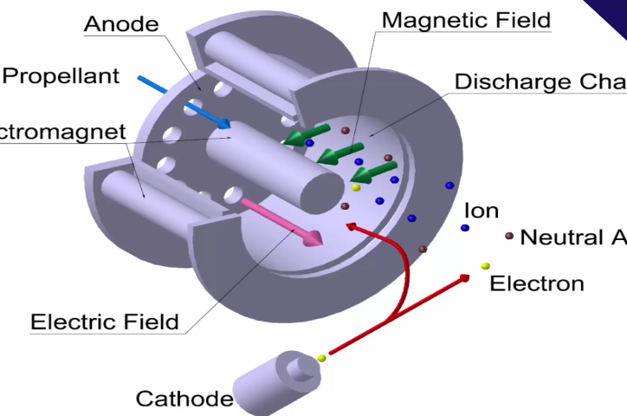
Let’s See Few Snaps…..

Slide 10
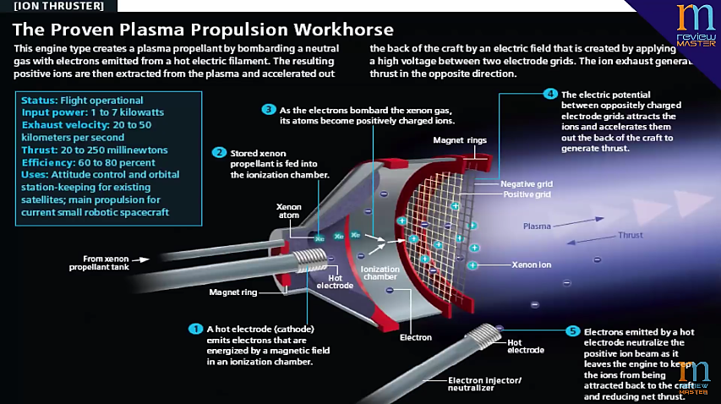

Slide 11
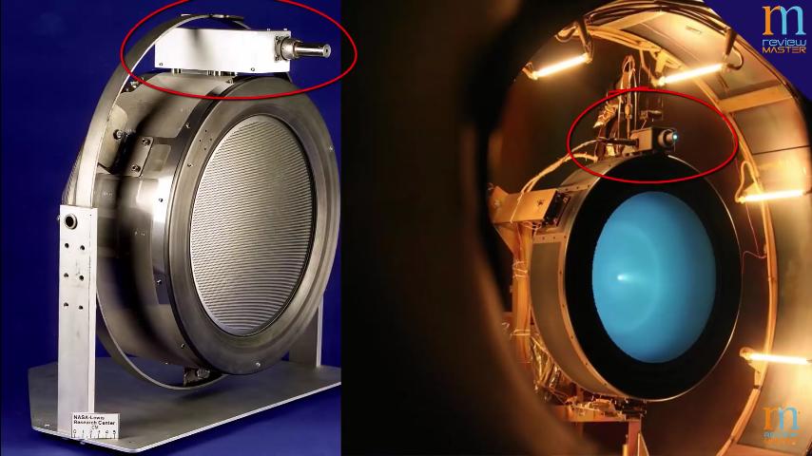

Slide 12


Slide 13
Let’s See the System Electrically……………

Slide 14
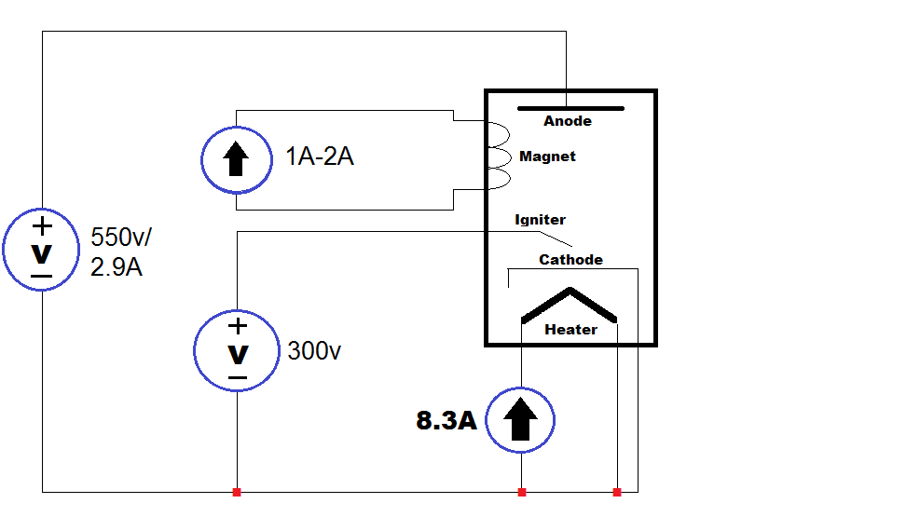
Let’s View It Thro’ An Electric Engineer’s Eye…

Slide 15
Let’s See that ; What We Designed…

Slide 16
The Technology That We Used
THE THREE MAJOR POWER SUPPLY TECHNOLOGIES
1. Linear regulators.
2. Pulsewidth modulated (PWM) switching power supplies.
3. High efﬁciency resonant technology switching power supplies.

Slide 17
DESIGN FLOW OF PWM SWITHING POWER SUPPLY

Slide 18
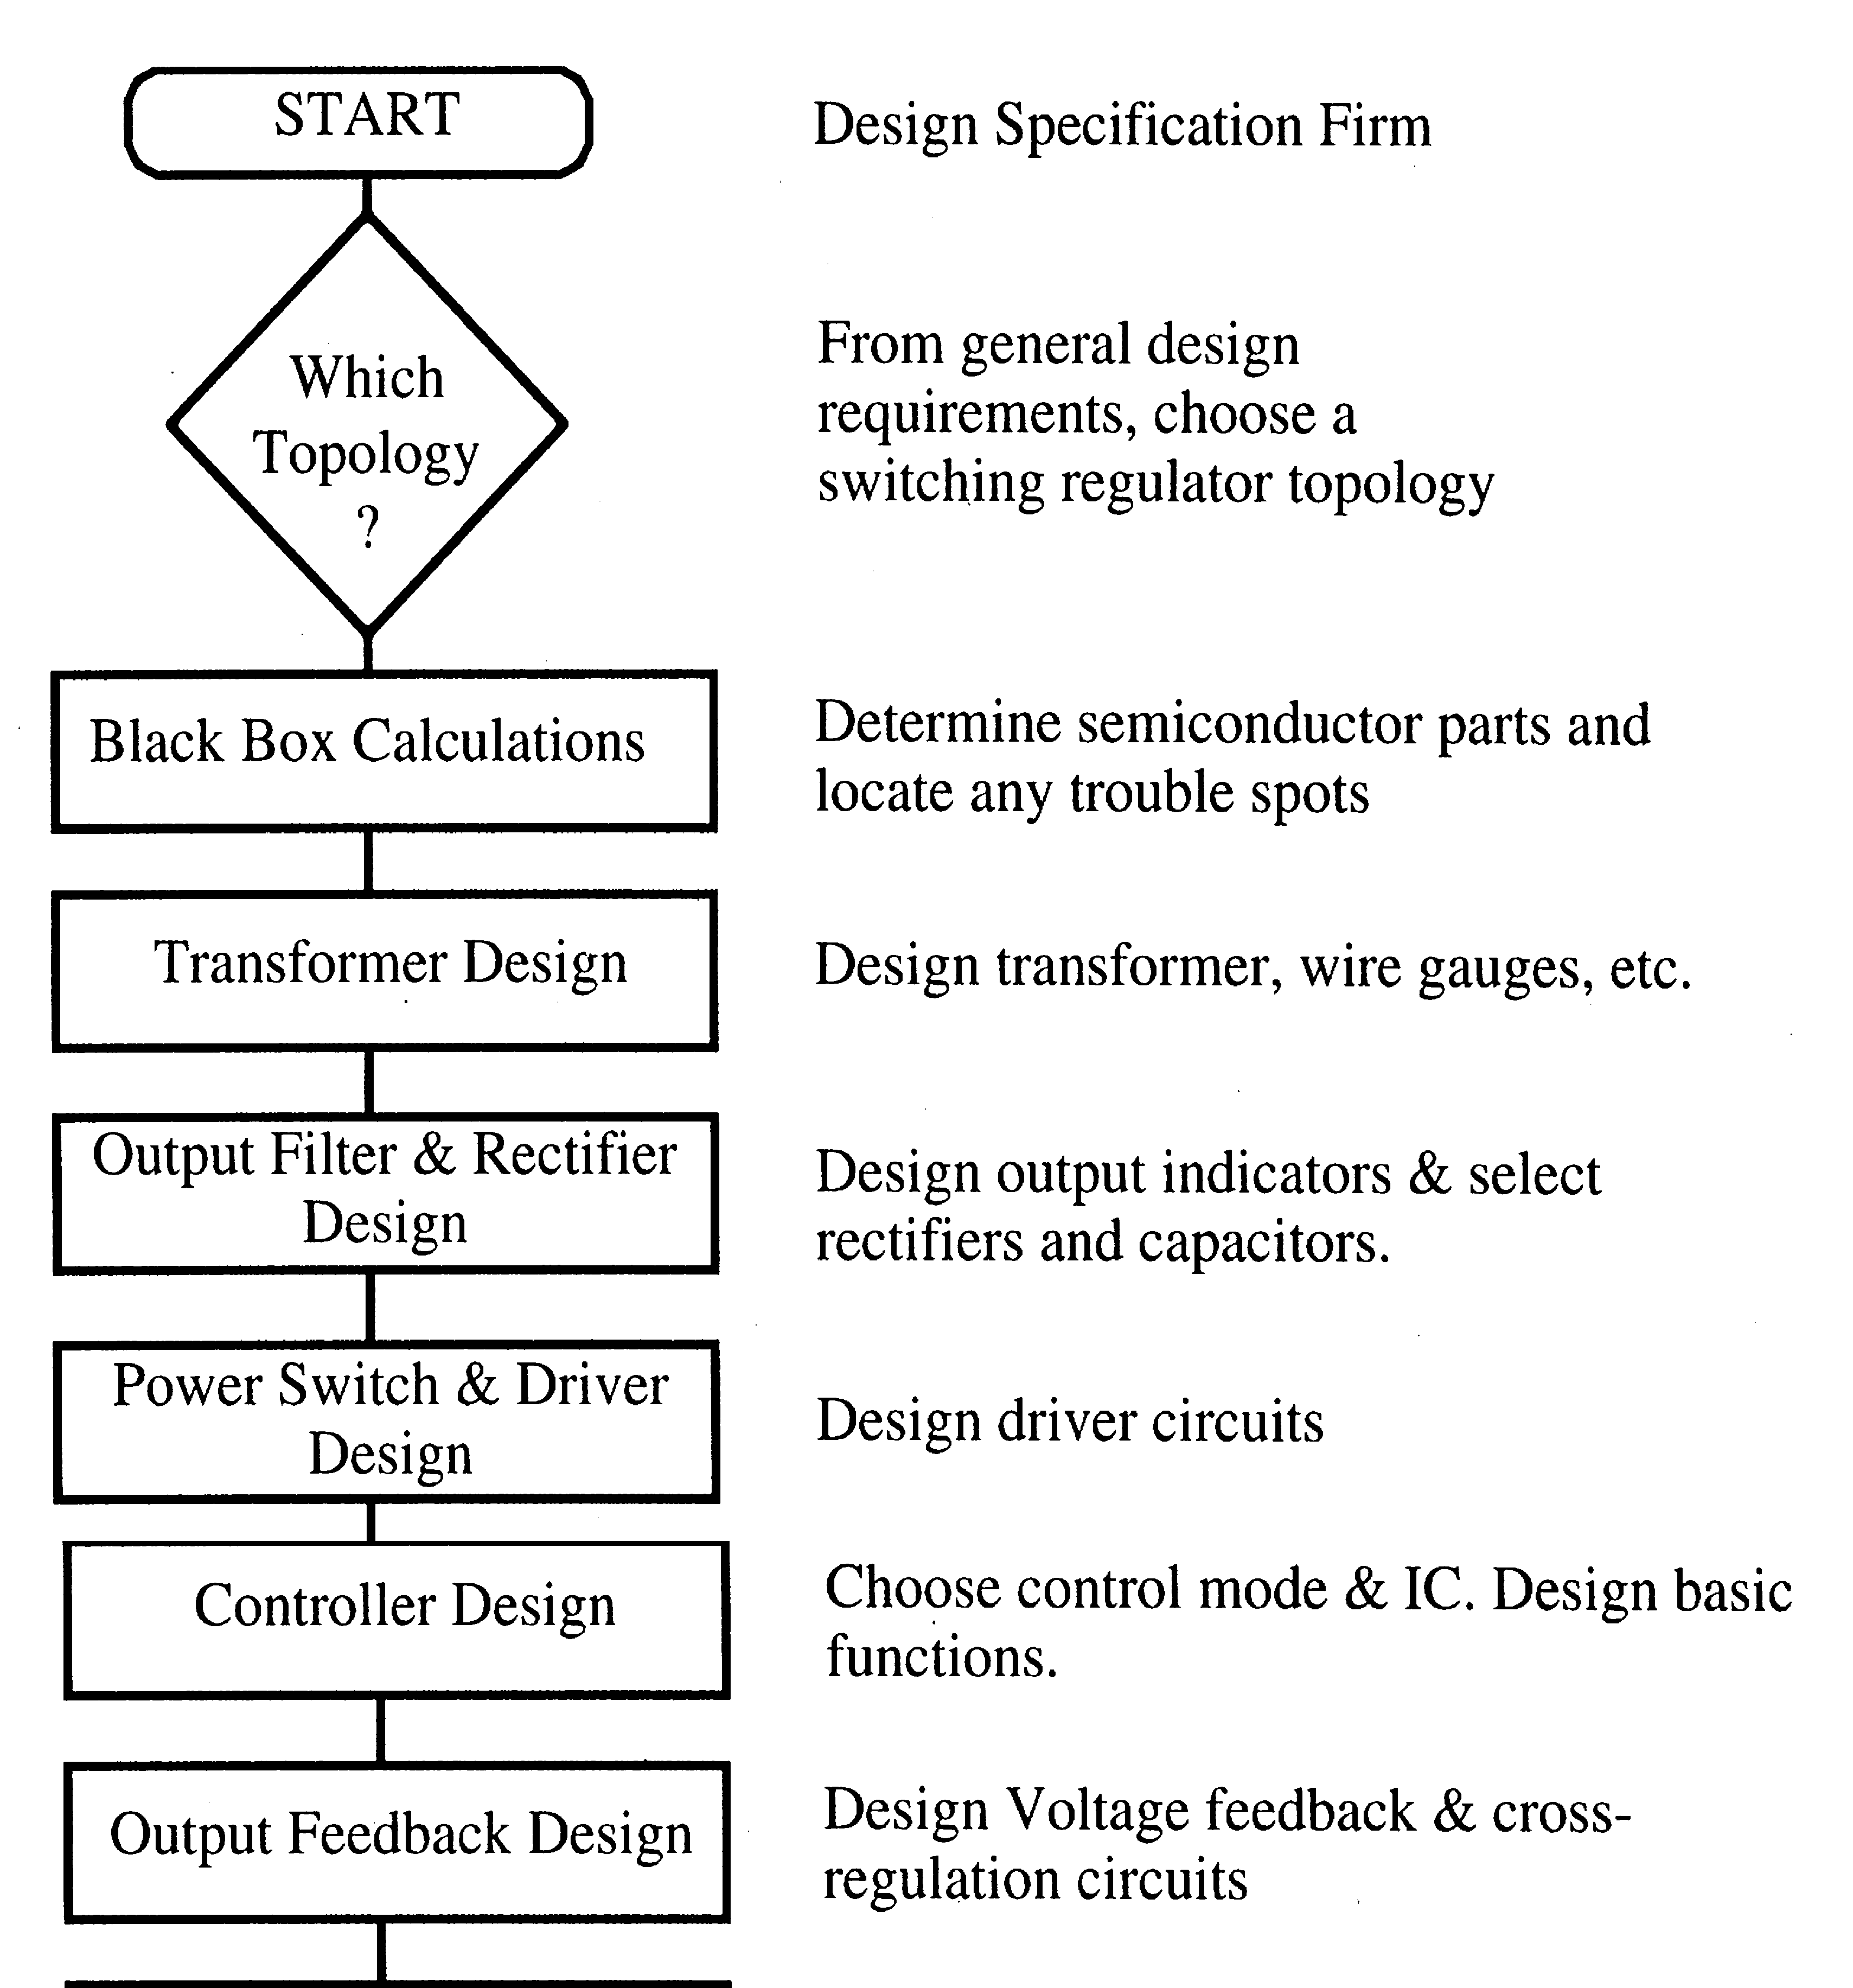

Slide 19
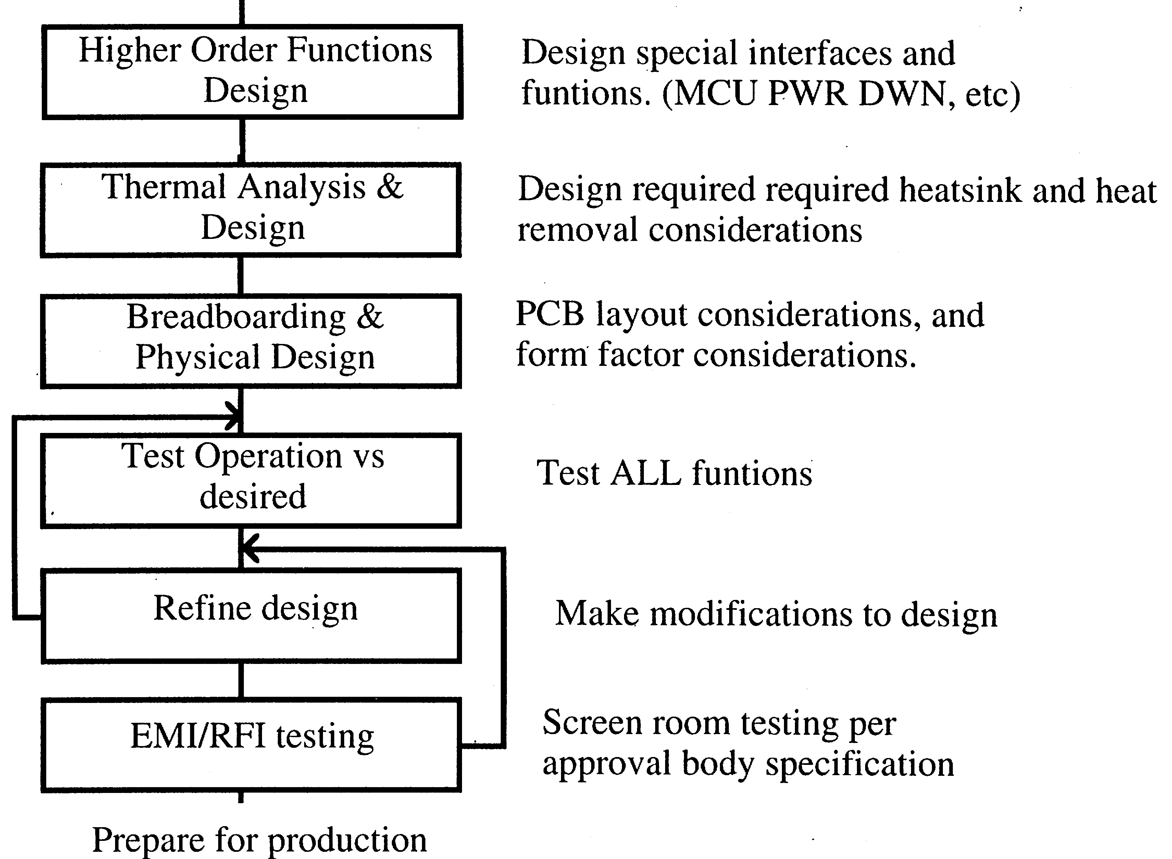

Slide 20
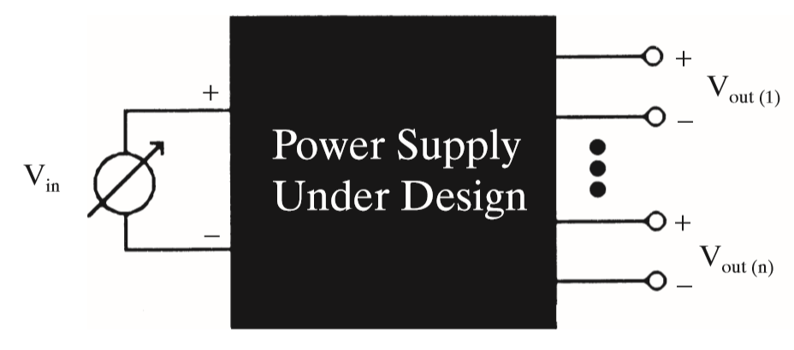
BlackBox Calculations
SPECIFICATIONS :
Input Voltage Range = 3v-40v
Max. Output current = 8.3A max
Load Resistance = 2Ω to 4Ω
Switching freq. = 100khz
Opert. Environment =-25°C to +55°C
Ground isolation =In FWRD/FDBK

Slide 21
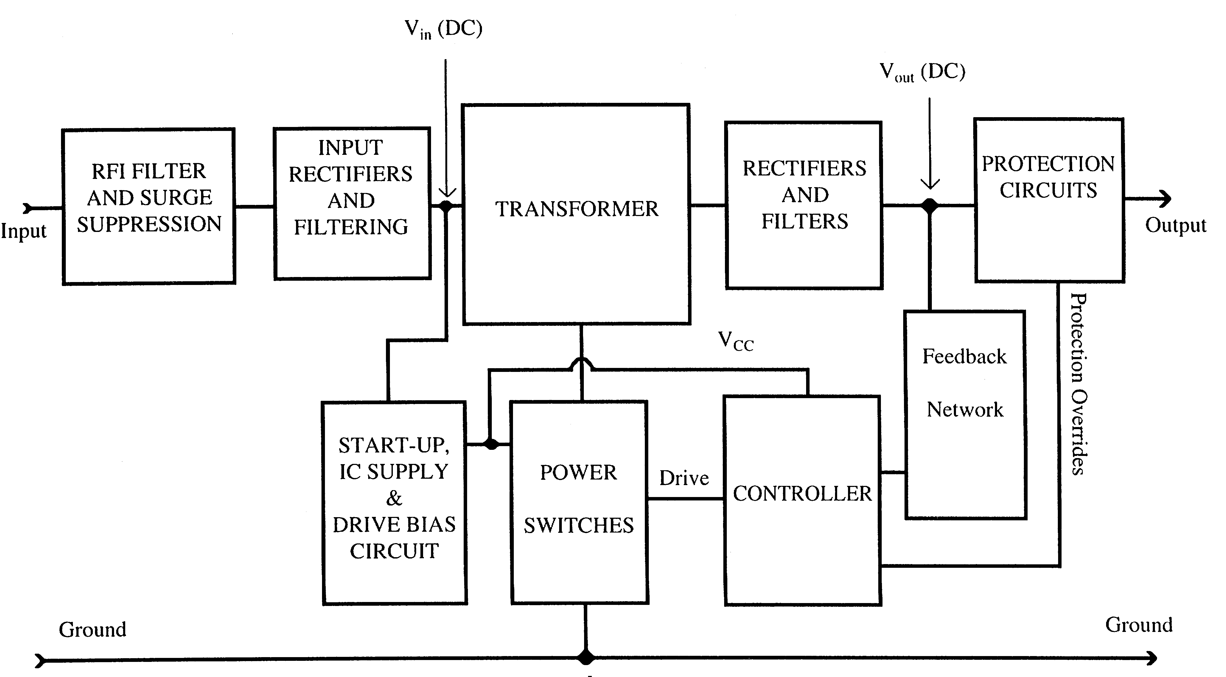
This Is How The Block Diagram Is…

Slide 22
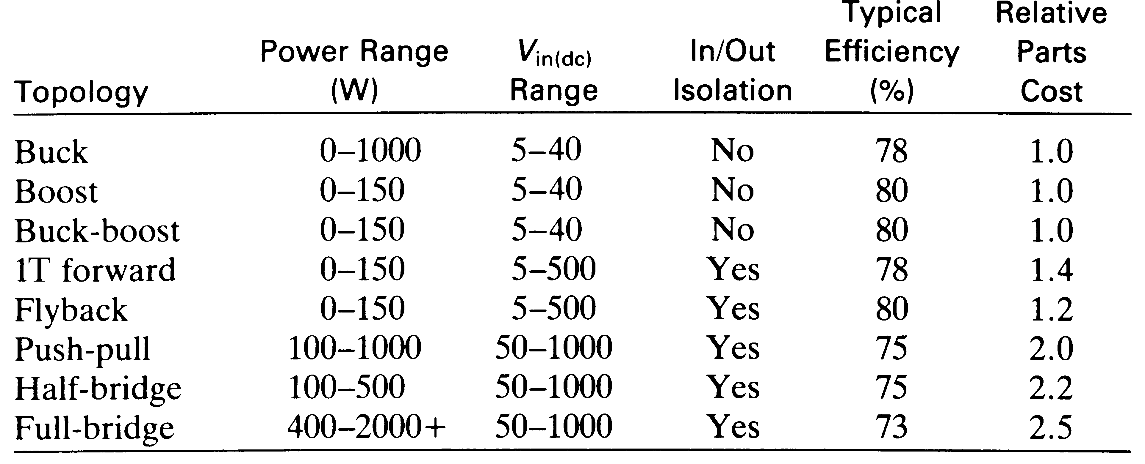
Which Topology of PWM Switching Power Supply to Use ?
Comparison of the PWM Switching Regulator Topologies

Slide 23
FACTORS PREFERRED FOR DETERMINING THE OPTIMUM TOPOLOGY
a. Transformer isolation is needed.
b. Peak current through the power switches.
c. Maximum operating voltage across the power switches.
d. The input voltage appears across the primary winding of the transformer.
e. System efficiency.
f. Parts count.

Slide 24
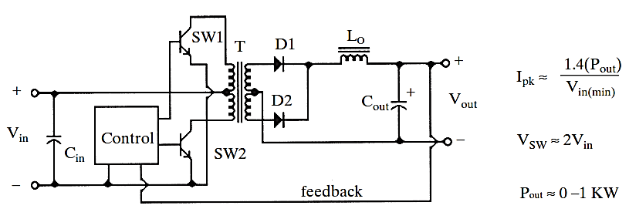
Push Pull Converter Topology
Push Pull Converter Circuit Diagram

Slide 25
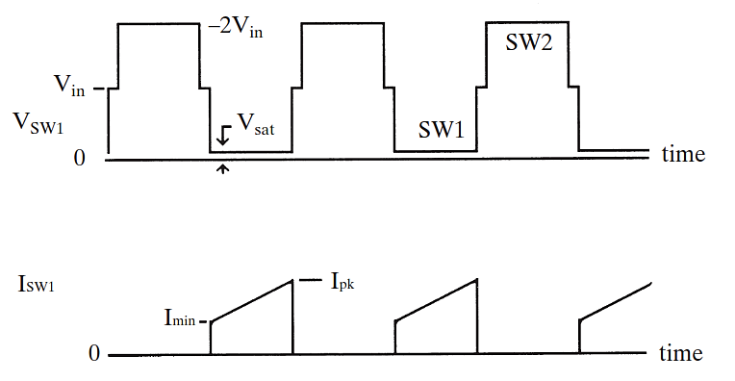
Push Pull Converter Voltage & Current Waveforms

Slide 26
Limitation of Push Pull Converters
core saturation due to flux unbalance
--Reduced by pulse by pulse current protection
Double ended topology

Slide 27
Selecting the Controller IC
Selecting the Optimum Control Method
Voltage mode control
Current mode control
Voltage-mode control
The important trait of voltage-mode control is that the error voltage is placed into a PWM comparator
and compared against a clock generated sawtooth waveform.
As the error voltage rises and falls the pulsewidth of the output signal increases and
decreases.
To identify a voltage-mode control IC, look for a capacitor R-C oscillator
and see if the capacitor sawtooth voltage goes to a comparator with the error
voltage.

Slide 28
Selecting the Controller IC
PWM Control Methods
Control Method | Optimum topology | Issues
Voltage-mode with average OC foldback | Forward-mode | OC foldback slow, could cause power switch failures
Voltage-mode with pulse-to-pulse OC limiting | Forward-mode | Very good OC protection; usually hi-side current Sensing
Hysteretic current- mode | Forward- and boost-mode | Heavily patented; few control ICs
Current-mode, turn-on with clock | boost | Current-mode, turn-on with clock

Slide 29
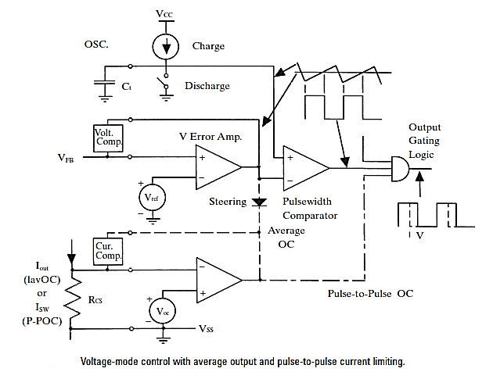
Selecting the Controller IC

Slide 30
Selected UC1825 as Controller IC
FEATURES OF UC1825 IC
• Compatible with Voltage or Current Mode Topologies
• Practical Operation Switching Frequencies to 1MHz
• 50ns Propagation Delay to Output
• Wide Bandwidth Error Amplifier
• Pulse-by-Pulse Current Limiting
• Soft Start / Max. Duty Cycle Control
• Low Start Up Current (1.1mA)

Slide 31
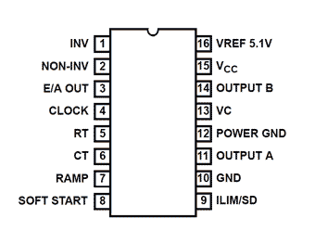
Controller Diagrams
The Features Adopted For Selecting The Controller IC Are:
Ability to operate directly from the input voltage.
Pulse to pulse over current limiting.
Totem pole MOSFET drivers.
UC1825

Slide 32
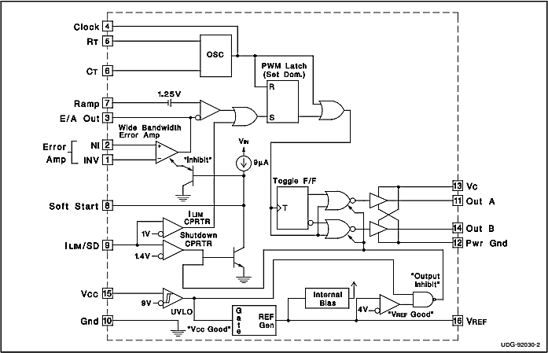
INTERNAL BLOCK DIAGRAM OF UC1825 IC

Slide 33
PWM Controller
Generates PWM signal for MOSFET Switchs
Two signals from Out A & Out B of Opp.phases
Dutycycle is determined by Error signal generated from Feedback

Slide 34

Designing PWM Switching Frequency @96khz
Oscillator design
The PWM switching frequency is half of the frequency of ramp signal.
ie. F$sw=1/2(Framp)$
$$frequency of ramp,F=\frac{1.44}{\dot{R}×C}$$
Let C =2000pf & F =192Khz
Then R =4.51kΩ

Slide 35
VARIATION OF DUTY CYCLE IN UC1825
Vin [1NV volts] | EA out | PWM Duty cycle
 |  | OUTA | OUTB
0V | 5V | 47% | 46%
0.5V | 4.76V | 47% | 46%
1.4 V | 3.8V | 41% | 40%
1.5V | 3.7V | 35% | 37%
1.7V | 3.5V | 30% | 32%
1.9V | 3.3V | 26% | 26%
2.0V | 3.2V | 24% | 23%
2.1V | 3.1V | 20% | 20%
2.3V | 2.9V | 15.3% | 15%
2.4V | 2.8V | 10% | 10%
2.6V | 2.5V | 5% | 5%
2.6V | 2.5V | 5% | 5%

Slide 36
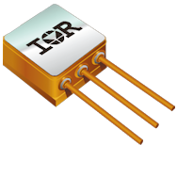
POWER MOSFET AS SWITCHES
MOSFET Is Selected Because:
Significantly faster switching time.
Saturation voltage of MOSFETs are close to power transistors.
Simple drive circuitry
The absence of a second breakdown failure mechanism.
The ability to be paralleled.
Stable gain and response time over a wide temperature range.
MOSFET can work from 50 KHz to above 1 MHz.

Slide 37
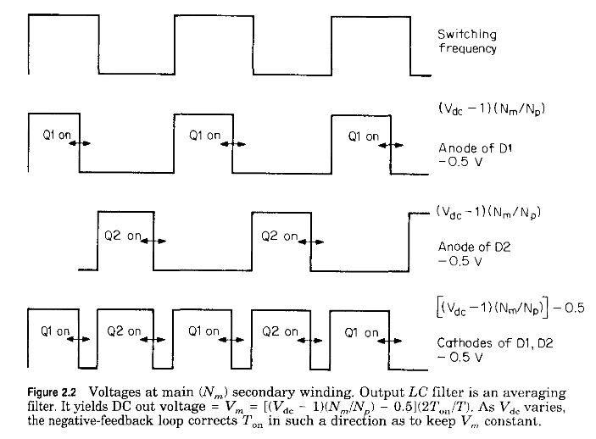
POWER MOSFET AS SWITCHES
2N7269 Power MOSFET is selected
Can Switch upto peak current 26A
High Vdss(200v)
Very low Rds on (0.094Ω)
Gate voltage = 10v

Slide 38
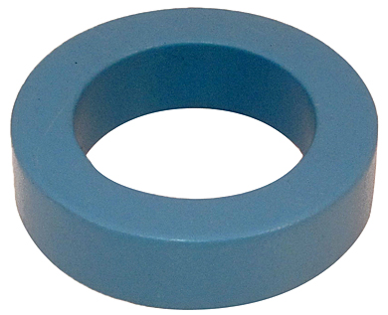
TRANSFORMER
Selection Of Transformer Core
Type of core selected = Ferrite toroid core
The product of Window Area in cm² (Wa) and Core Area in cm² (Ac) is given by:
WaAc = 1000 P D / f Bmax
WaAc = 2.35cm⁴
Core 47313-TC from Magnetics is selected, Having WaAc =25.2 cm⁴

Slide 39
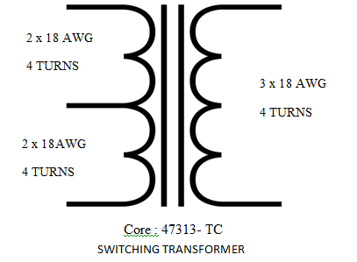
TRANSFORMER
PRIMARY TURNS
Primary no. of turns (Np) is selected based on Faraday’s Law
Np = Vp / (dΦ / dt)
Np = Vp ∆T x 108 /Ac ∆B
WE GOT No. OF PRIMARY TURNS = 4 Turns
2 x 18AWG wire with diameter 1.02mm is selected for primary winding

Slide 40
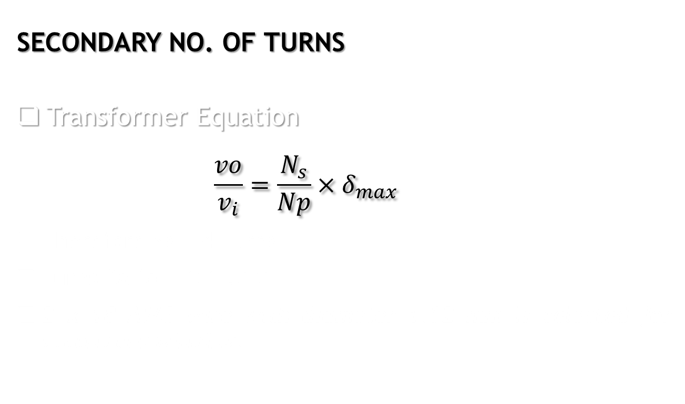
TRANSFORMER
SECONDARY NO. OF TURNS
Transformer Equation
$$\frac{vo}{v_{i}}=\frac{N_{s}}{Np}×δ_{max}$$
Therefore Ns = 4 Turns
Turns Ratio = 4:4….1:1
2 x 18 AWG wire with diameter 1.02 mm is selected for secondary winding.
Max. Output voltage Vomax = 16.6V
Input voltage =30v & Dmax=.8

Slide 41
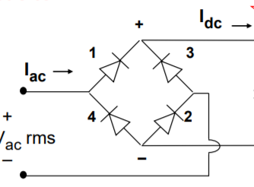
Output Stage
BRIDGE RECTIFIER
Rectifiers convert AC into DC
Looks like a Wheatstone bridge
Does not require a center tapped transformer
Requires 2 additional diodes
Voltage drop is double

Slide 42
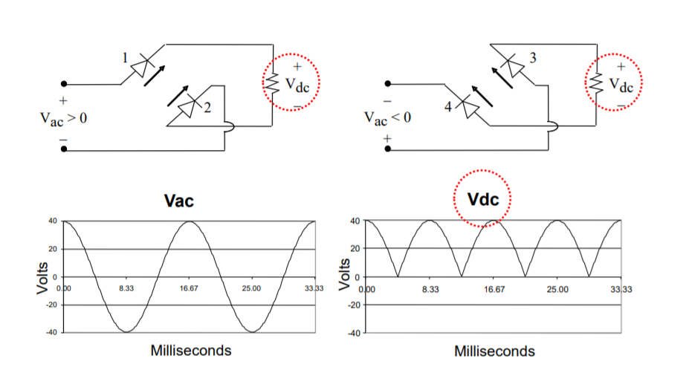
Output Stage

Slide 43
Output Stage
BRIDGE RECTIFIER DESIGN
Diode selection Criteria
Voltage load capacity,
With 50% derating of Current > 8.3A x 2 > 16.6A
Current load capacity,
With derating of 80% on PIV,
The PIV rating should be > 20.75V
Permissible operating areas
HFA35HB60 is Selected Rectifier Diode
HFA35HB60 Diode Features
Characteristics | Maximum Value | Unit
D.C. Reverse Voltage | 600 | Volts
Continuous Forward Current | 22 | Amperes
Maximum Power Dissipation | 83 | Watts
Operating Junction and Storage Temperature Range | -55 to 150 | `C

Slide 44
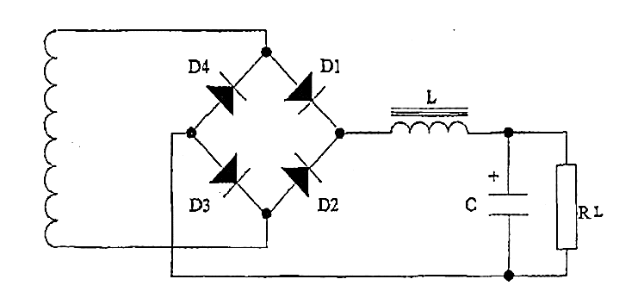
Output Stage -FILTERS
For AC Signal
Capacitors---SHORT CIRCUIT
Inductors----OPEN CIRCUIT
For DC Signals
Capacitors---OPEN CIRCUIT
Inductors----SHORT CIRCUIT
The AC of the will flow through C and be blocked by the inductor
The DC will not pass through the capacitor but will pass through the L

Slide 45
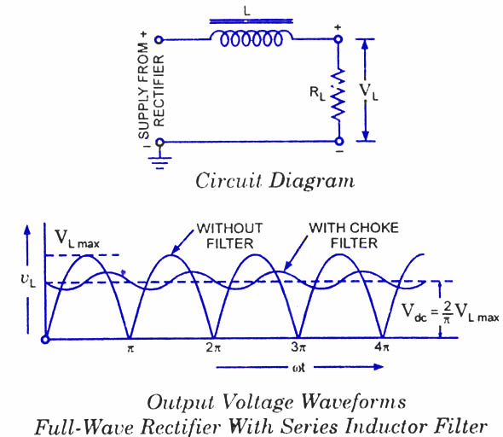
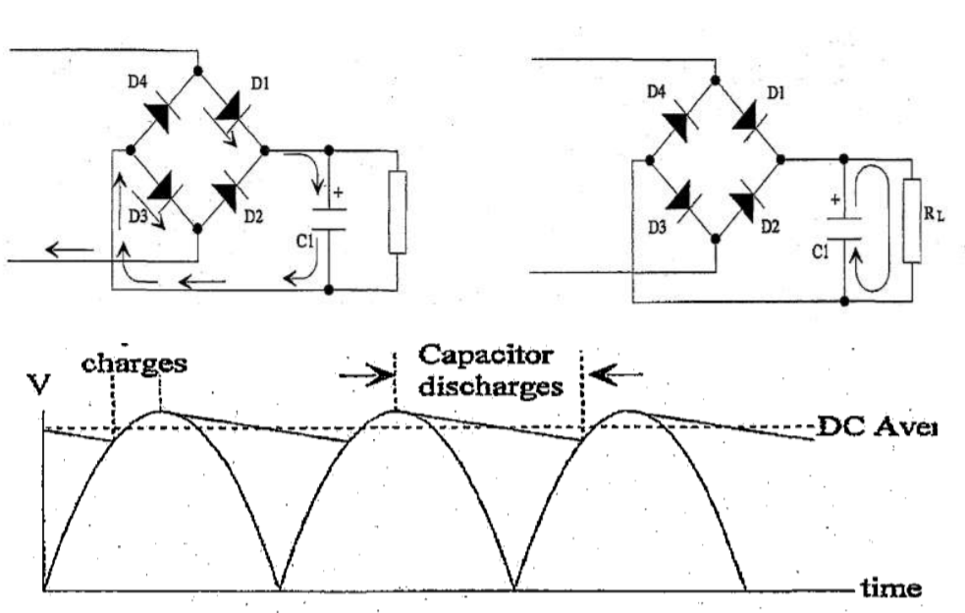
Output Stage -FILTERS

Slide 46
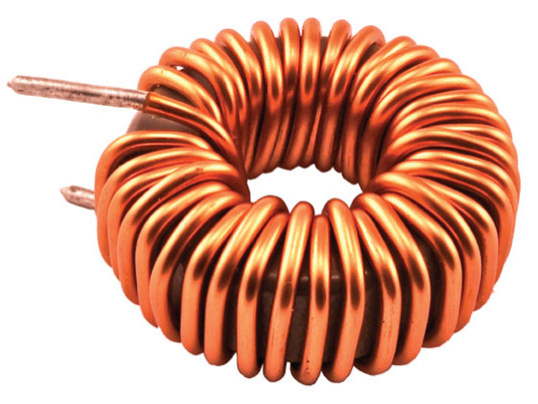
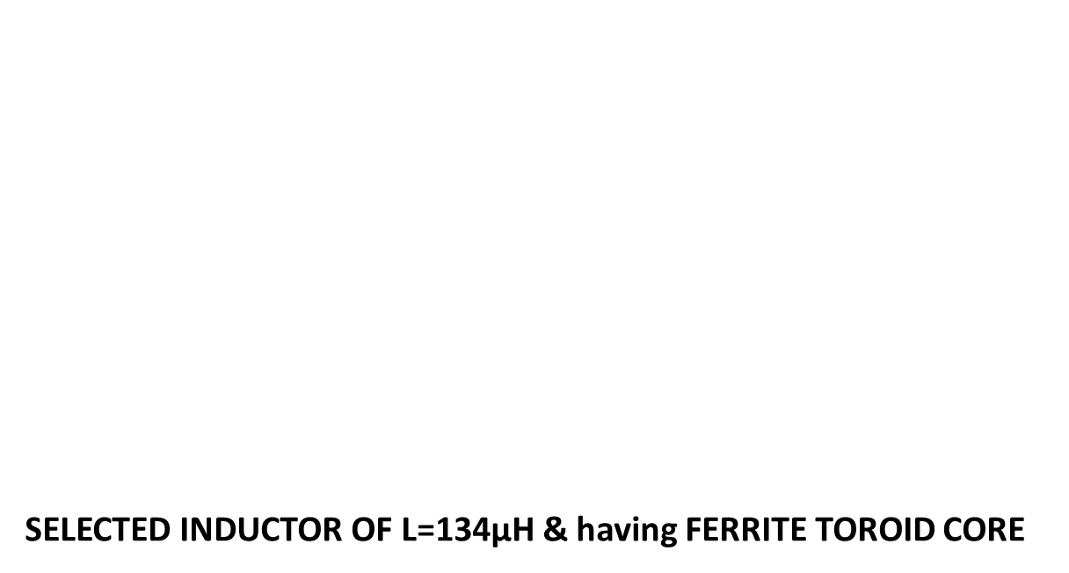
Output Stage
INDUCTOR DESIGN
Used to remove Current Ripple
Inductor current, I = 8.3A
Δ I = 10% of I = 0.83A
Turn OFF Time
$$Toff = [1−Vout / Vin x n] / f$$
Toff= 4.28 µs
Inductance,L
$$L = Vripple x Toff / I$$
L= 86 µH
SELECTED INDUCTOR OF L=134µH & having FERRITE TOROID CORE

Slide 47
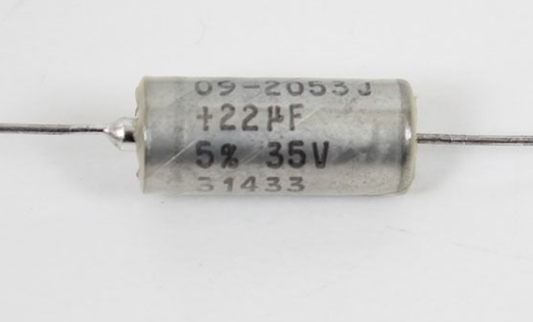
Output Stage
CAPACITOR DESIGN
Used to reduce voltage ripple
The output filter is designed for a frequency of 5 kHz
F = 1 / 2π√LC
C = 7.3 µF
THREE 22µF,100V CAPACITORS ARE PUT IN PARALLEL

Slide 48
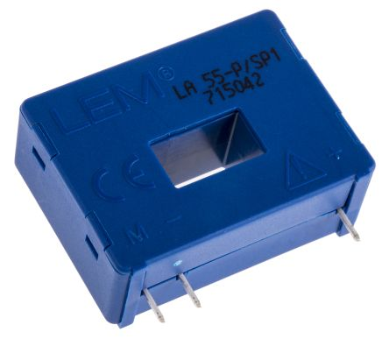
LEM AS CURRENT SENSOR
LEM FEATURES
• Excellent linearity
• Outstanding long-term stability
• Low residual noise
• High frequency response
• High reliability

Slide 49
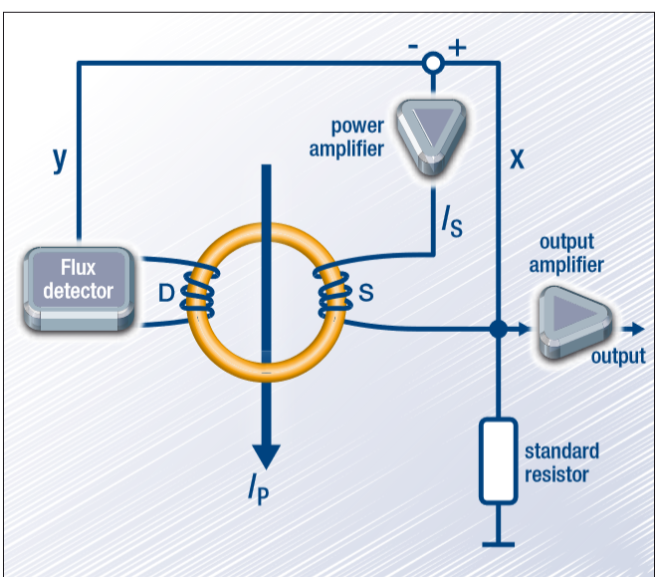
Hall-effect Sensor
HALL EFFECT CURRENT SENSOR WITH INTERNAL INTEGRATED CIRCUIT AMPLIFIER.
When electrons flow through a conductor, a magnetic field is produced.
This has several advantages:
1.No additional resistance (a shunt) need be inserted in the primary circuit.
2.Also, the voltage present on the line to be sensed is not transmitted to the sensor, which enhances the safety of measuring equipment.

Slide 50
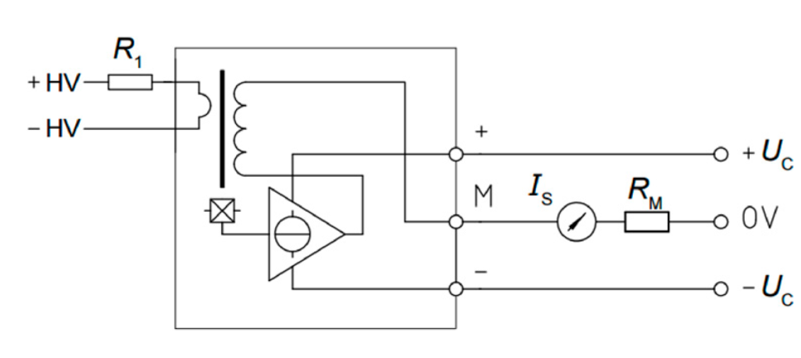

LEM Eq. & Connection
LEM EQUATION
$$Vmonit. = \left(\frac{\frac{o}{p}Current}{1000}\right)x Rm x Pri. Turns$$
Primary turns = 4 turns
Resistor,Rm = 100k
Trans. Ratio = 1:1000

Slide 51
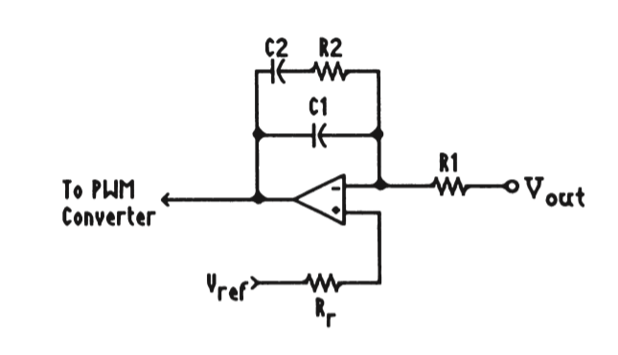
Output Feedback
Stability Criteria:
Phase margins of 45-60°
Gain margin above 6-∞dB
Pole-Zero Compensation
Has a pole at dc that provides the open-loop op amp gain for good output regulation
A zero is introduced at or below the output ﬁlter pole (to compensate for the phase lag by that pole).
The last pole is put into the compensation to roll off the gain at high frequencies

Slide 52
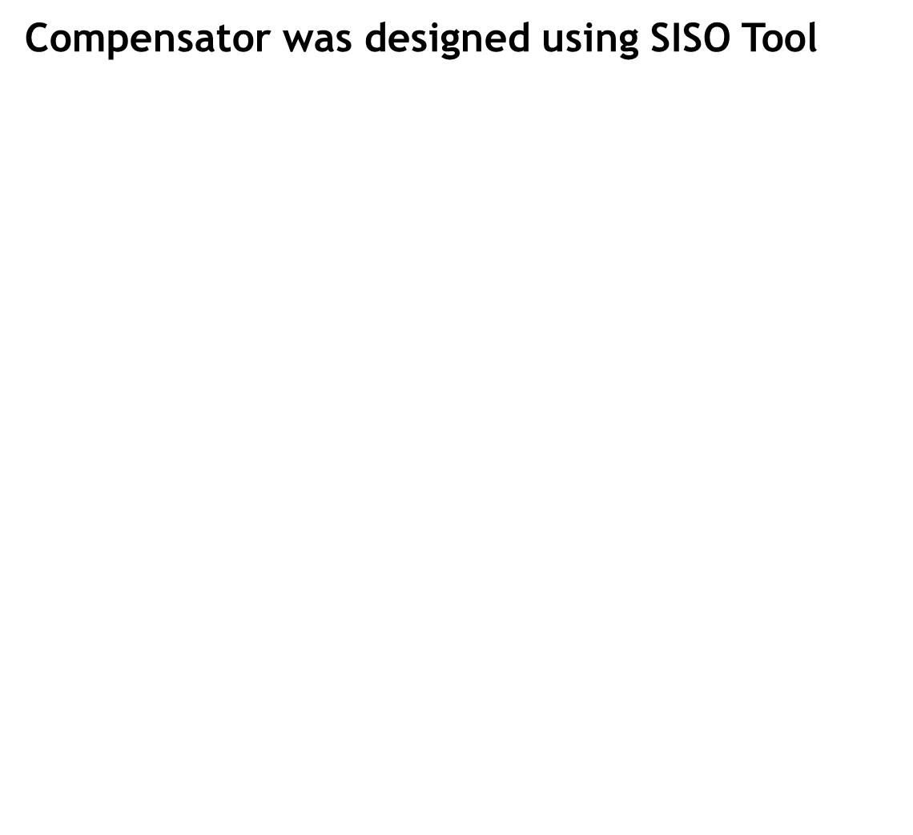
Output Feedback
Compensator was designed using SISO Tool
Transfer function, T(s) = $\frac{K \left( 1 + \frac{s}{sZ}\right)}{s \left(1+\frac{s}{sP}\right)}$
T(S) = $\frac{1200 \left(1 + \frac{S}{28700}\right)}{S \left(1+ \frac{S}{159000}\right)}$
SZ = 1 / R2C1 C2 = 8000pF
SP = $\frac{C1 + C2}{R2C1C2}$ C1 = 3480pF
K = 1 / (C1 + C2)R1 R2 = 10kΩ
R1 = 70kΩ

Slide 53
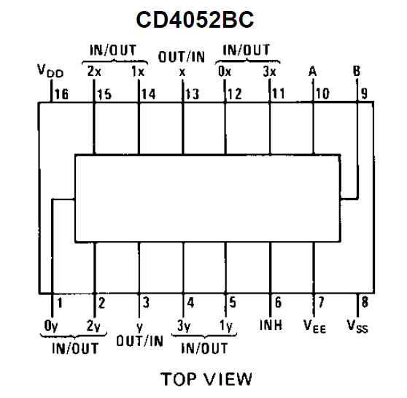
MULTIPLEXER
MULTIPLEXER IC CD4052B
4-channel analog multiplexer
Having 2 binary control inputs
The 2 binary i/p signals select 1 of 4 pair channels to be turned ON
Then connect the diff. analog inputs to the diff. O/Ps.
CD4052BC

Slide 54

MULTIPLEXER
DESIGN:
Controller reference voltage 5.1V
$$Vo = Vin x R2 / (R1 + R2)$$
R1 = 1K
R2 = 2K
R3 = 3K
R4 = 3K
R5 = 2K
Programming Input |  | Selected Channel | Output current | Reference voltage
A | B
0 | 0 | X0 | 2A | 0.8v
1 | 0 | X1 | 4A | 1.6v
0 | 1 | X2 | 6A | 2.4v
1 | 1 | X3 | 8A | 3.2v

Slide 55
THE FINAL PRODUCT

Slide 56
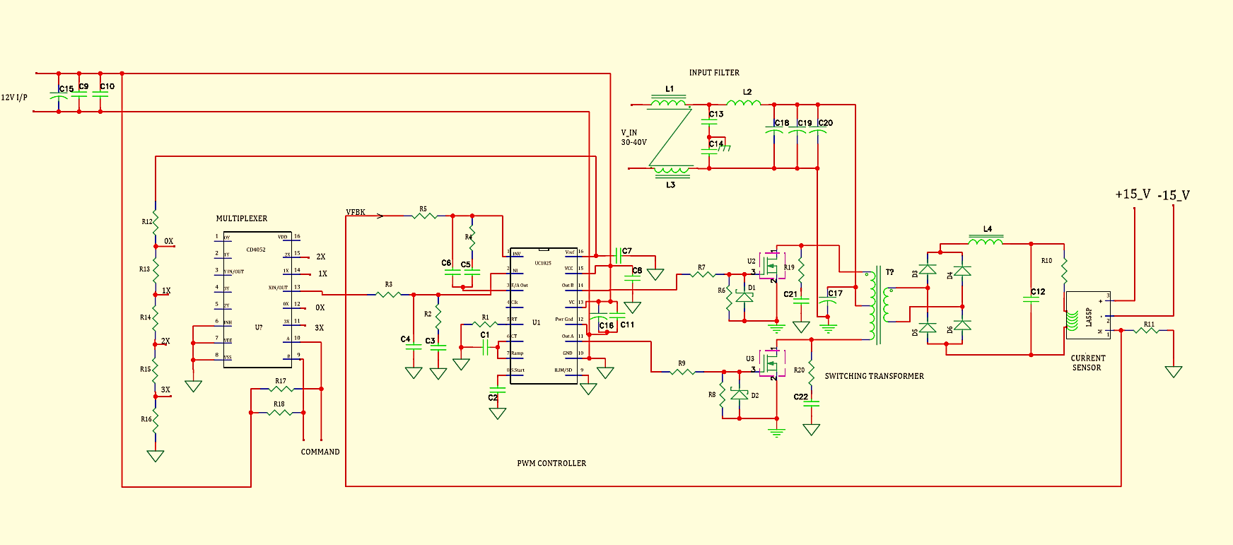

Slide 57
Thank You

